Slide 1
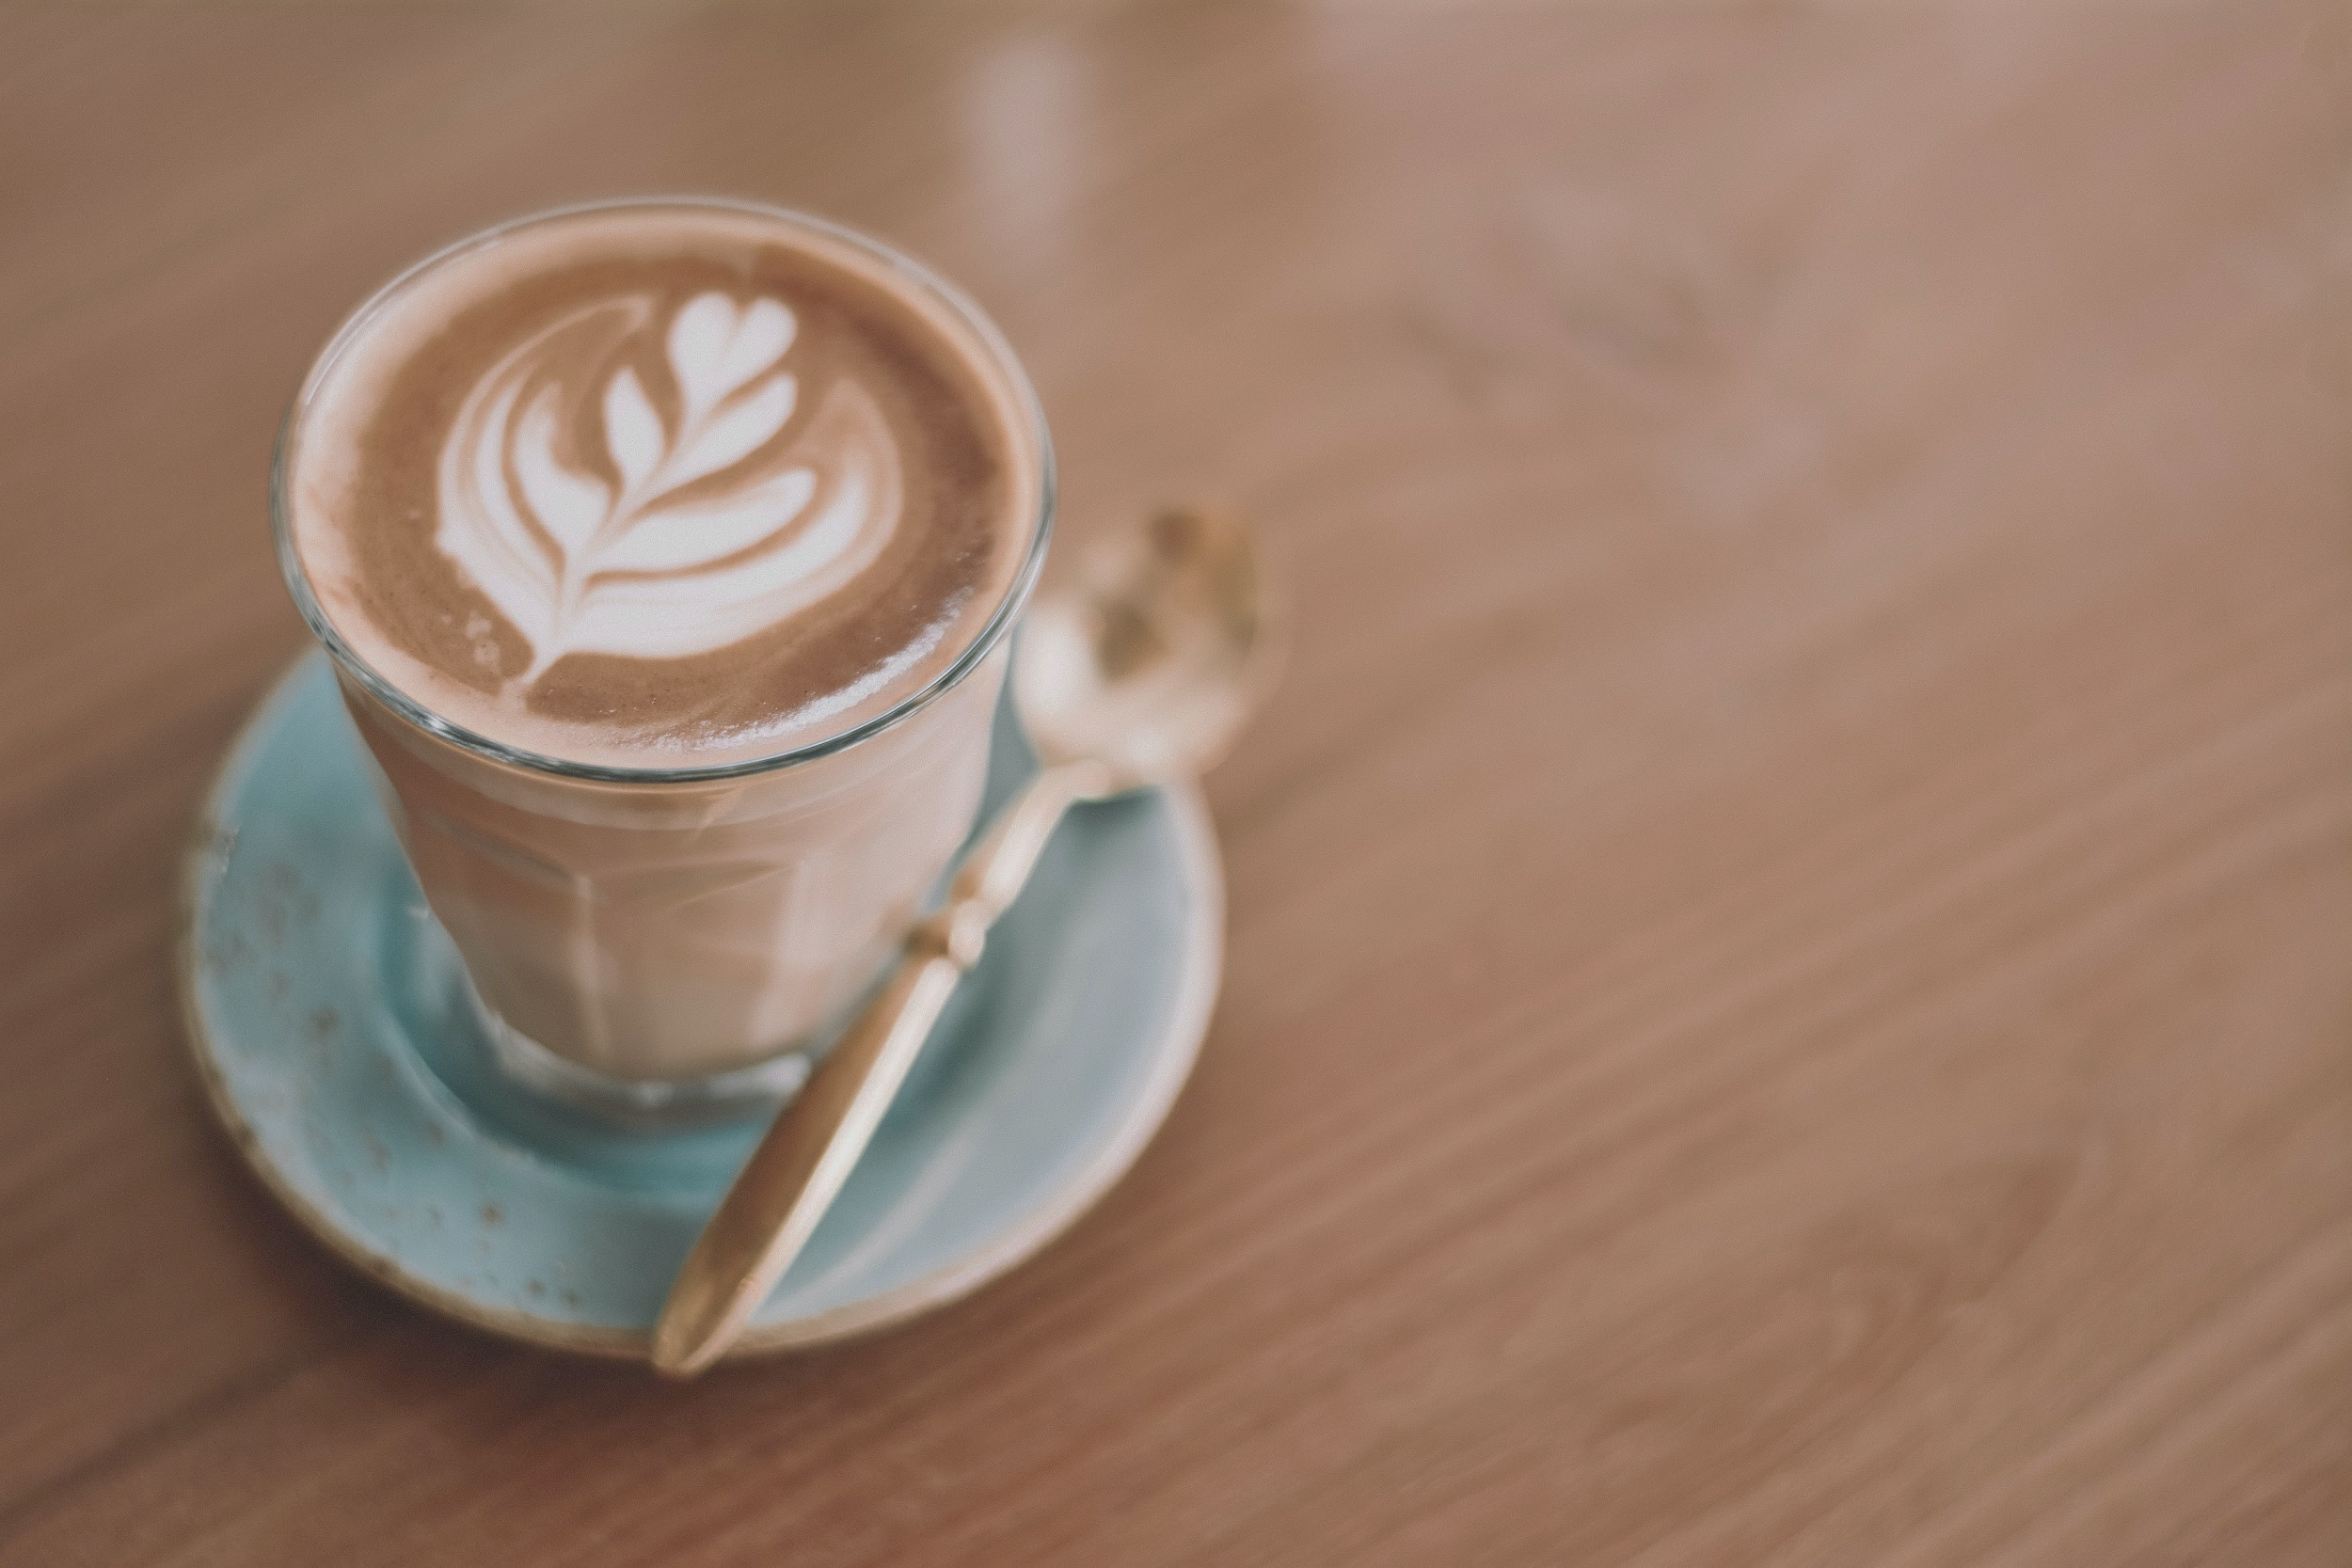

Driving Business Improvement - Central Perk Coffee
Xiaowen Tang
Yuanzhe Wang
Ryan Burger
Farhad Mughal
Vikram Payyavula

Slide 2
Roadmap
Suggested Strategies
Business Problem
Customer Analysis
Assumptions & Metrics

Slide 3

Overview of Analysis
GOAL
Evaluate customer loyalty
Smooth demand throughout each day
Develop potential marketing strategies

Slide 4
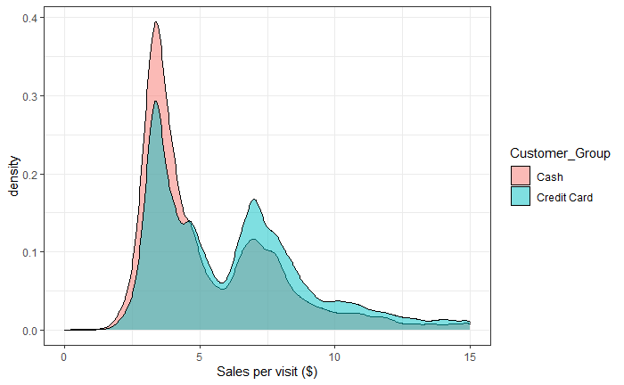
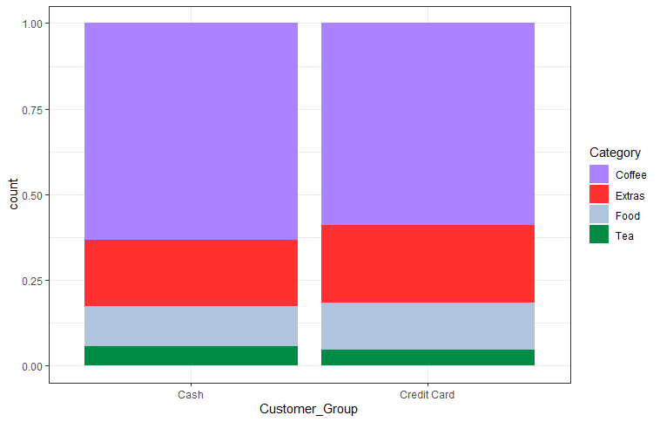
Assumptions
Credit card users ≅ Cash users
61% of transactions were paid via credit card

Slide 5
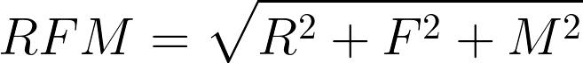
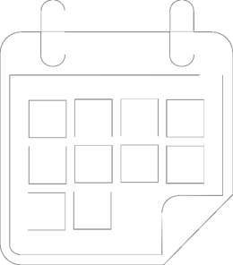

Measurement Method - Loyalty
Recency
How long has it been since the most recent purchase?
Frequency
How many items were purchased over the timespan of the data sample?
Monetary Value
What was the average price of each item purchased?

Slide 6
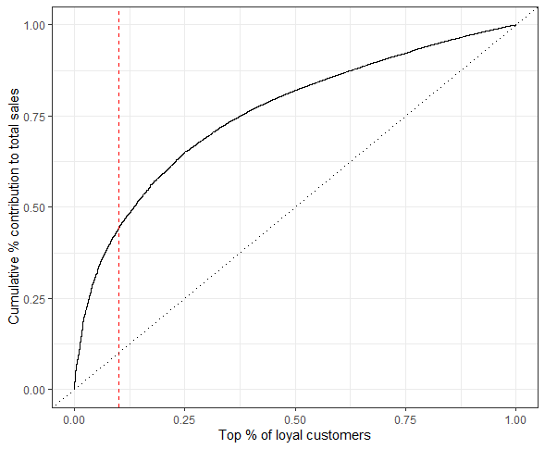


Defining Loyal Customers
Best Rated By RFM
Most loyal customers with RFM above specified cut-off
Choosing the Cut-off: 10%
Narrow focus
45% of gross sales
Over 3000 customers
10% of loyal customers

Slide 7

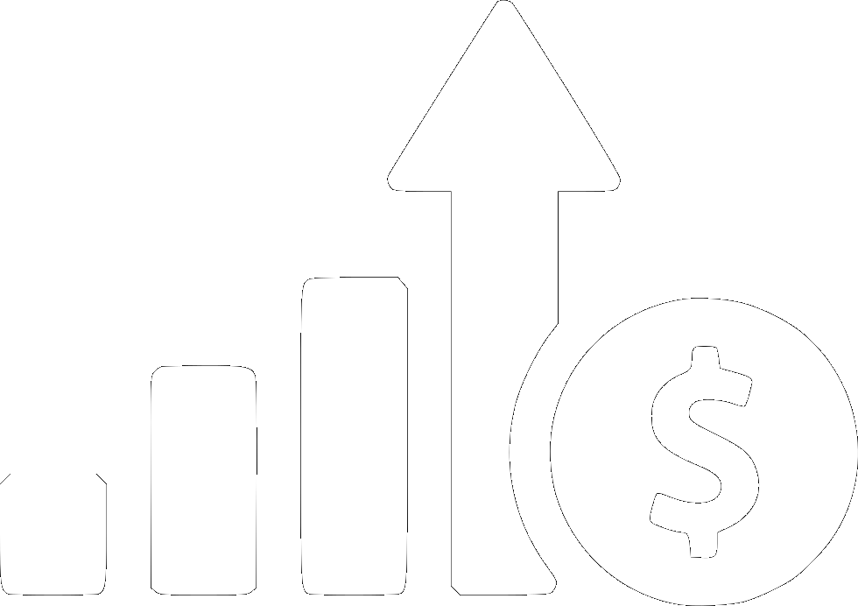


Why focus on loyal customers?
Increased Profitability
Predictable
01
03
- Loyal customers contributed 45% of the total gross sales.
- 5% increase in retention rates can increase your profits by up to 95% (Bain & Company).
Non-loyal customers’ purchase choices are more random while loyal customers have distinctive purchase patterns.
Cost Reduction
Need to Improve
04
Although the number of loyal customer is increasing, the spending per person is decreasing over years.
02
It can cost up to 5 times more to acquire a new customer than it does to retain an existing customer. (Bain & Company).
Notes:
Why we choose to focus on loyal customers instead of the whole customer group?
First, loyal customers are more profitable
They made up 10% of total customers but contributed 45% of the total gross sales. And study shows that 5% increase in retention rates can increase profits by up to 95%.
Second, it cost less.
It cost more to acquire a new customer than it does to retain an existing customer.
Third, loyal customers are more predictable
While non-loyal customers’ purchase choice appeared to be random. Loyal customers have more distinctive purchase patterns which conveys more information.
Finally, the spending per loyal customer is decreasing over the years, which means loyal customers are losing their loyalty.

Slide 8
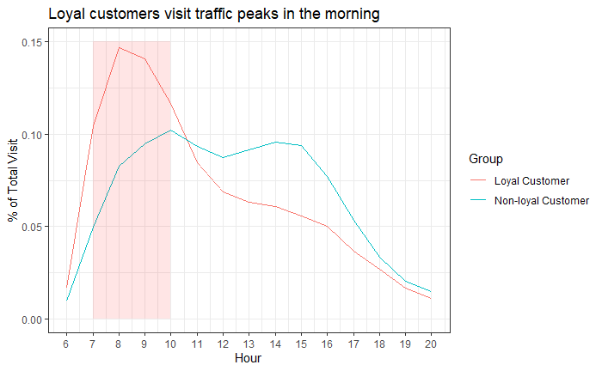
Loyal Customer Group- Commuters
Commuters
Notes:
What are the loyal customer group? By understanding the loyal customer group, we can develop more targed strategies.
Based on our analysis, we believe, morning commuters take a large portion of loyal customers.
From the graph we can see that Loyal customers visited the coffee shop mostly in the morning while non-loyal customers show a more random visit pattern throughout the day.

Slide 9



Loyal Customers Group - Commuters
73% of the loyal customers purchase coffee in the weekday mornings, which is common time when people commute to work.
01
02
In NYC, 63.4% of the people who buy coffee in the morning are commuters.
Notes:
More specifically, 73% of loyal customers purchase coffee during weekday mornings, which is common time when people commute to work. We further analyzed data of new york coffee drinkers, 63% of the people who buy coffee in the morning are commuters.
Therefore, we believe that morning commuters take a large part of loyal customers.

Slide 10

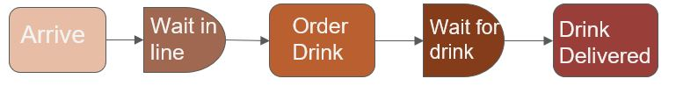
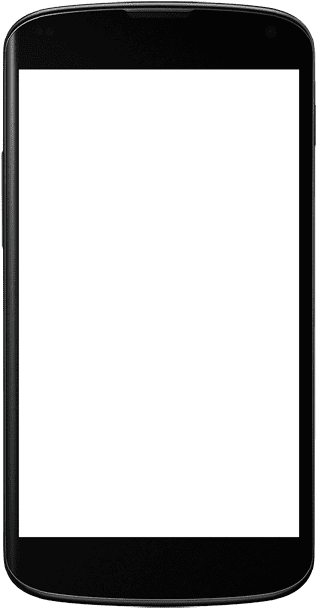


Recommendations
Morning: Increase Efficiency by reducing customers’ waiting time
Pre-Order
Introduce a Pre-Order service for commuters to order in advance to decrease their order waiting time.
$7.96
Bundle Sales
Cappuccino + Croissant
Latte + Donut
Cappuccino + Lenka bar
+
Source:- https://www.wowapps.com/why-every-restaurant-needs-a-pre-ordering-system/
Notes:
Cappuccino and Croissant are frequently brought together, and the possibility of co-purchasing is 1.02 times higher than random chance.
the major assumption behind the bundle price simulation is that customer would only purchase the bundle if the bundle price is lower their reservation prices for both items. Then we simulated customers’ reservation prices for bundle items and bundle price, when bundle price is $7.96, the coffee shop can maxmize profit

Slide 11

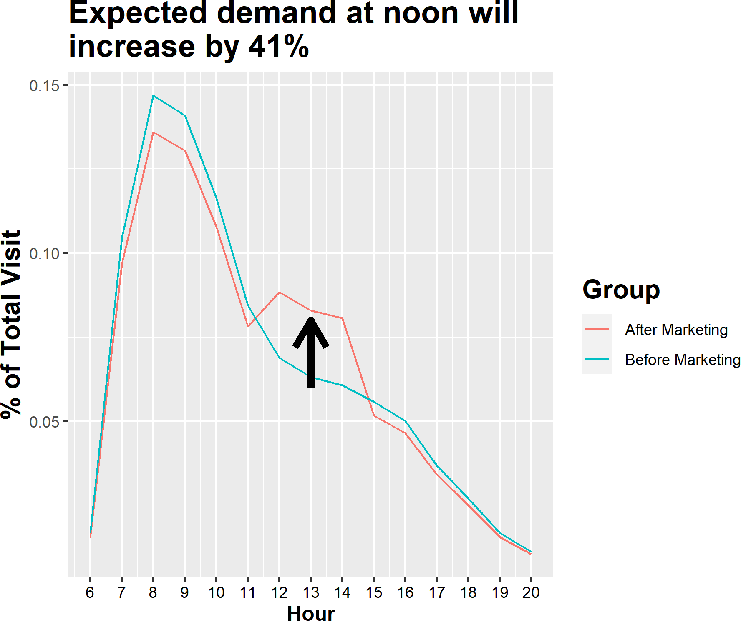
Recommendations
Afternoon: Increase Sales by offsetting delivery fee with same-day coupons
Uber Eats/Doordash Partnership
Buy coffee in the morning, get a coupon for delivery in the afternoon
Pre-ordering can be done in these apps saving a cost of $80000 a year
Source:- https://squareup.com/us/en/payments/coffee

Slide 12
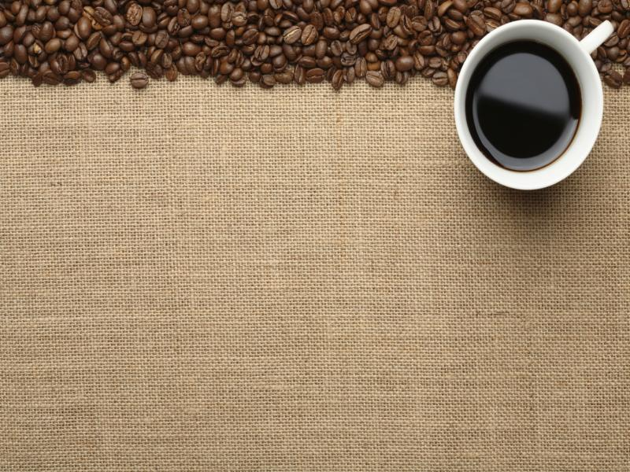
Thank You

